Slide 1
Environmental, Health and Safety Department
Hazards Communication Plan

Slide 2
TEXAS HAZARD COMMUNICATION ACT (THCA) CH. 502 OF THE TEXAS HEALTH AND SAFETY CODE (HSC)
Requires all public employers in Texas to provide their employees with information regarding hazardous chemicals to which employees may be exposed in their workplace.
Section 502.009(b) and Section 295.7(a) of the THCA Rules (Title 25 of the Texas Administrative Code (TAC), Section 295.1 – 295.13)
Hazard Communication Program

Slide 3
TABLE OF CONTENTS
SOUTH TEXAS COLLEGE (STC) COMMITMENT
SOUTH TEXAS COLLEGE PLEDGE
EMPLOYEE RESPONSIBILITY
ENVIRONMENTAL, HEALTH, AND SAFETY RESPONSIBILITY
EXEMPTIONS
WORKPLACE CHEMICAL LIST (HSC §502.005 and 25 TAC §295.4)
SAFETY DATA SHEETS and/or MATERIAL SAFETY DATA SHEETS (HSC §502.006 and TAC §295.5)
CHEMICAL CONTAINER LABELS (HSC §502.007 and TAC §295.6)
TRAINING PROGRAM (HSC §502.009 and 25 TAC §295.7)
REPORTING EMPLOYEE DEATHS AND INJURIES (HSC §502.012 and 25 TAC §295.9)
EMPLOYEE NOTICE (HSC §502.0017 and 25 TAC §295.12)
PERSONAL PROTECTIVE EQUIPMENT (HSC §502.017 and 25 TAC §295.12)
MAINTAINING EMPLOYEE RIGHTS (HSC §502.017 and 25 TAC §295.12)

Slide 4
SOUTH TEXAS COLLEGE (STC) COMMITMENT
South Texas College is firmly committed to providing a safe and healthy work environment for all students, faculty, staff and visitors.
Policy CG Safety Program

Slide 5
SOUTH TEXAS COLLEGE PLEDGE
A chemical list will be updated and maintained annually by the Environmental, Health Safety (EHS) department, when applicable.
Each department will maintain existing labels on containers received at any STC location.
Ensure Safety Data Sheets (SDS)/Material Safety Data Sheets (MSDS) accompany all hazardous chemicals delivered.
EHS department will collaborate with other departments to educate and train employees and students on the hazards associated with handling, storing, use and disposal of workplace chemicals.
Each department will provide proper personal protective equipment required to complete assigned tasks.
Upon request, provide all contractors, outside vendors and special groups with information, including access to applicable MSDS forms (excepting trade secrets), regarding hazardous chemicals in their areas of operation. ·

Slide 6
EMPLOYEE RESPONSIBILITY
Follow all warnings on product labels.
NEVER remove, deface, or cover up warning labels on chemical products.
Ask their Supervisor or Instructor where the SDS/MSDS are kept in the instructional or work area.
Safety Data Sheet/Material Safety Data Sheet.
Wear personal protective equipment appropriate for each assigned task.
Avoid unnecessary exposure to hazardous chemicals.

Slide 7
ENVIRONMENTAL, HEALTH, & SAFETY RESPONSIBILITY
Maintain current workplace chemical lists for all work areas.
Obtain and maintain all applicable SDS/MSDS in the chemical list.
Make available to contractors and vendors the appropriate SDS/MSDS information in the chemical list.
Periodically audit employees' awareness of hazardous chemicals.
Coordinate emergency service responses to chemical accidents.
Keep records of annual hazard communication plan training.

Slide 8
EXEMPTIONS
Per Section 502.004(f), the following chemicals are exempt from the requirements of the THCA and are outside the scope of this written program:
Hazardous waste that is subject to regulation by the Texas Commission on Environmental Quality (TCEQ) and/or the U.S. Environmental Protection Agency (EPA).
A chemical in a laboratory under the direct supervision or guidance of a technically qualified individual if:
Labels on incoming containers are not removed
The laboratory is not used primarily to produce hazardous chemicals in bulk or commercial purposes
Tobacco or tobacco products
Food, drugs, cosmetics or alcoholic beverages
Wood or wood products
Radioactive waste

Slide 9
WORKPLACE CHEMICAL LIST (HSC §502.005 AND 25 TAC §295.4)
STC will develop and maintain a list of hazardous chemicals normally present in the workplace in excess of 55 gallons or 500 pounds.
This Workplace Chemical List will be developed for each workplace where such quantities of hazardous chemicals are used or stored and will be available for review by employees and their designated representatives.
The EHS department will be responsible for reviewing and updating the Workplace Chemical List(s) for STC annually. The Workplace Chemical List will be maintained for at least 30 years.

Slide 10
SAFETY DATA SHEETS and/or MATERIAL SAFETY DATA SHEETS (HSC §502.006 and TAC §295.5)
Each department will maintain a current and appropriate Safety Data Sheet (SDS) or Material Safety Data Sheet (MSDS).
No hazardous chemical will be used in the workplace unless an SDS/MSDS has been obtained and is on file in the work area.
Material safety data sheets will also be made readily available, upon request, to employees' designated representatives.

Slide 11
CHEMICAL CONTAINER LABELS (HSC §502.007 and TAC §295.6)
All containers of hazardous chemicals used or stored shall be appropriately labeled.
Identity of the chemical as it appears on the SDS.
Appropriate hazard warnings.
Name and address of the manufacturer.
All department should rely on manufacturers or distributors to provide labels.
Waste Containers labels should include Type of waste (hazardous, universal, or non-hazardous) and accumulation date.

Slide 12
TRAINING PROGRAM (HSC §502.009 and 25 TAC §295.7)
In conjunction with the hazard communication requirements, STC will provide an education and training program to all employees who routinely use or handle hazardous chemicals.
Supervisors must ensure all employees receive the following trainings:
Hazard Communication Plan
SDS/MSDS
Safe handling procedures, proper use of PPE
Location of hazardous chemicals
Required training records are maintained and include:
Date of the training
List of employees
Subjects covered
Name of instructors
New employees are trained prior to their required use of
hazardous chemical
These trainings are to be provided annually

Slide 13
REPORTING EMPLOYEE DEATHS AND INJURIES (HSC §502.012 and 25 TAC §295.9)
South Texas College will notify the Texas Department of State Health Services, Division for Regulatory Services, Policy, Standards & Quality Assurance Unit, Environmental Hazards Group.
Reportable incidents:
Any employee accident involving a hazardous chemical exposure or asphyxiation
Fatal accidents to one or more employees
Hospitalization of five or more employees
All accidents involving a hazardous chemical, shall be reported to the Environmental, Health, and Safety Department and submit an Incident Report Form.

Slide 14
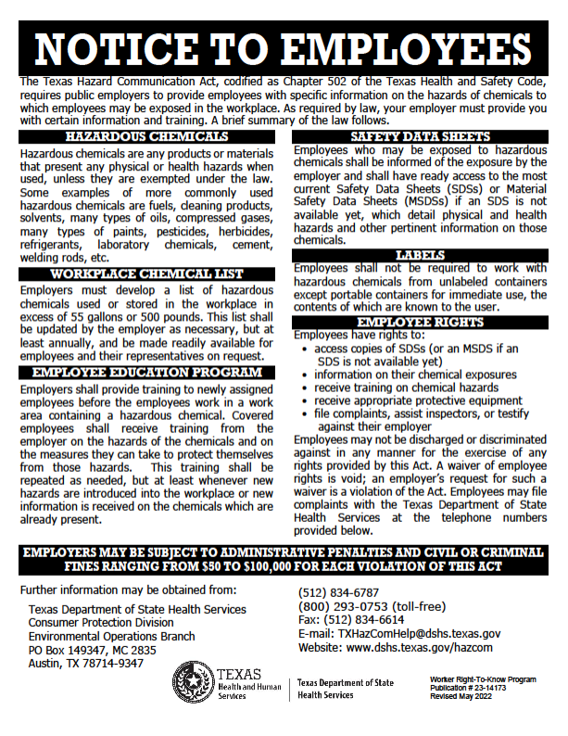
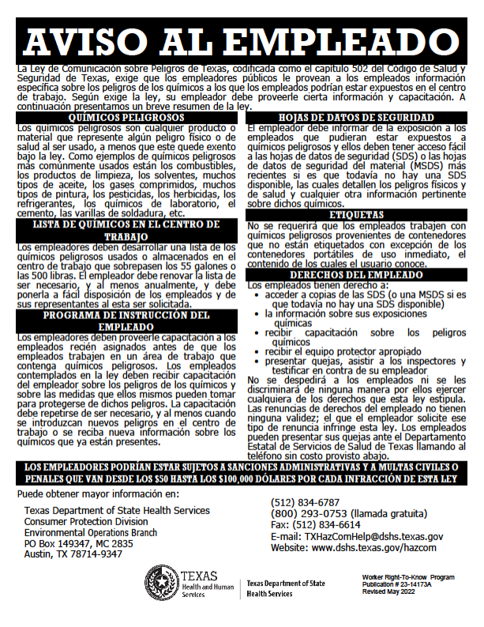
EMPLOYEE NOTICE (HSC §502.0017 and 25 TAC §295.12)
South Texas College will post and maintain the most current version of the THCA Notice to Employees, at locations where hazardous chemicals are used or stored, informing employees of their rights.

Slide 15
PERSONAL PROTECTIVE EQUIPMENT (HSC §502.017 and 25 TAC §295.12)
South Texas College will provide appropriate personal protective equipment (PPE) to all employees who use or handle hazardous chemicals.
The Director/Department Chair will assume overall responsibility for the PPE program and will ensure that appropriate equipment and training is provided.
This training is based on the duties performed, manufacturer’s specifications on proper use of PPE, and appropriate maintenance and storage of PPE.

Slide 16
MAINTAINING EMPLOYEE RIGHTS (HSC §502.017 and 25 TAC §295.12)
South Texas College shall not discipline, harass, or discriminate against any employee for filing complaints, assisting inspectors of the Texas Department of State Health Services, participating in proceedings related to the Texas Hazard Communication Act, or exercising any rights under the Act.
Employees cannot waive their rights under the Texas Hazard Communication Act. A request or requirement for such a waiver by STC is a violation of the Act.

Slide 17
QUESTIONS
ENVIRONMENTAL, HEALTH, AND SAFETY
DEPARTMENT

